Slide 1

















Slide 2
1-4 Voltage
As explained briefly in the previous section, to move the electron in a conductor in a particular direction requires some work or energy transfer.
This work is performed by an external electromotive force (emf), typically represented by the battery in Fig. 1.2. This emf is also known as
voltage or potential difference. The voltage 𝑣_{𝑎𝑏} between two points a and b in an electric circuit is the energy (or work) needed to move a unit charge from a to b; mathematically
𝑑𝑤
𝑣_{𝑎𝑏} ≜ _{𝑑𝑞} (1.3)
Where 𝑤 is energy in joules (J) and q is charge in coulombs (C). The voltage 𝑣_{𝑎𝑏} or simply 𝑣 is measured in volts (V), named in honor of the Italian physicist Alessandro Antonio Volta (1745–1827), who invented the first voltaic battery. From Eq. (1.3), it is evident that
1 volt = 1 joule/coulomb = 1 newton-meter/coulomb
Thus,
Voltage (or potential difference) is the energy required to move a unit
charge through an element, measured in volts (V).
Figure 1.5 shows the voltage across an element (represented by rectangular block) connected to points a and b. The plus (+) and minus (−) signs are used to define reference direction or voltage polarity. The
𝑣_{𝑎𝑏} can be interpreted in two ways: (1) point a is at a potential of
^{𝑣}𝑎𝑏
volts higher than point b, or (2) the potential at point a with respect to point b is 𝑣_{𝑎𝑏}. It follows logically that in general
𝑣_{𝑎𝑏} = −𝑣_{𝑏𝑎} (1.4)

Slide 3
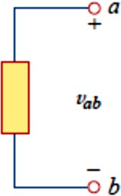
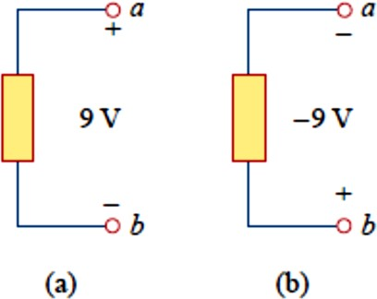
Fig. (1.5)
Polarity of voltage 𝑣_{𝑎𝑏}
For example, in Fig. 1.6, we have two representations of the same voltage. In Fig. 1.6(a), point a is +9 𝑉 above point b; in Fig. 1.6(b), point b is −9 𝑉 above point a. We may say that in Fig. 1.6(a), there is a 9-V voltage drop from a to b or equivalently a 9-V voltage rise from b to a. In other words, a voltage drop from a to b is equivalent to a voltage rise from b to a.
Fig. 1.6
Two equivalent representations of the
same voltage 𝑣_{𝑎𝑏} : (a) point a is 9 V above point b, (b) point b is −9 V above point a.
Current and voltage are the two basic variables in electric circuits. The common term signal is used for an electric quantity such as a current or a voltage (or even electromagnetic wave) when it is used for conveying information. Engineers prefer to call such variables signals rather than mathematical functions of time because of their importance in communications and other disciplines. Like electric current, a constant voltage is called a dc voltage and is represented by V, whereas a sinusoidally time-varying voltage is called an ac voltage and is

Slide 4
represented by v. A dc voltage is commonly produced by a battery; ac voltage is produced by an electric generator.
1-5 Power and Energy
Although current and voltage are the two basic variables in an electric circuit, they are not sufficient by themselves. For practical purposes, we need to know how much power an electric device can handle. We all know from experience that a 100-watt bulb gives more light than a 60-
watt bulb. We also know that when we pay our bills to the electric utility companies, we are paying for the electric energy consumed over a certain
period of time. Thus, power and energy calculations are important in circuit analysis.
To relate power and energy to voltage and current, we recall from physics that:
Power is the time rate of expending or absorbing energy, measured in
watts (W).
We write this relationship as
𝑑𝑤
𝑝 ≜ _{𝑑𝑡} (1.5)
Where p is power in watts (W), w is energy in joules (J), and t is time in seconds (s). From Eqs. (1.1), (1.3), and (1.5), it follows that
𝑑𝑤 𝑑𝑤 𝑑𝑞
𝑝 = _{𝑑𝑡} = _{𝑑𝑞} ∙ _{𝑑𝑡} = 𝑣𝑖 (1.6)
Or
𝑝 = 𝑣𝑖 (1.7)
The power p in Eq. (1.7) is a time-varying quantity and is called the instantaneous power. Thus, the power absorbed or supplied by an element is the product of the voltage across the element and the current

Slide 5
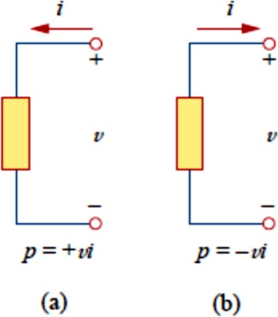
through it. If the power has a + sign, power is being delivered to or absorbed by the element. If, on the other hand, the power has a − sign, power is being supplied by the element. But how do we know when the power has a negative or a positive sign?
Current direction and voltage polarity play a major role in determining the sign of power. It is therefore important that we pay attention to the relationship between current i and voltage v in Fig. 1.7(a). The voltage polarity and current direction must conform with those shown in Fig.
1.7(a) in order for the power to have a positive sign. This is known as the passive sign convention. By the passive sign convention, current enters through the positive polarity of the voltage.
In this case 𝑝 = +𝑣𝑖 𝑜𝑟 𝑣𝑖 > 0 implies that the element is absorbing power. However, if 𝑝 = −𝑣𝑖 𝑜𝑟 𝑣𝑖 < 0, as in Fig. 1.7(b), the element is releasing or supplying power.
Fig. 1.7
Reference polarities for power using the
passive sign convention: (a) absorbing power, (b) supplying power.
Passive sign convention is satisfied when the current enters through the positive terminal of an element and 𝒑 = +𝒗𝒊. If the current enters through the negative terminal, 𝒑 = −𝒗𝒊.

Slide 6
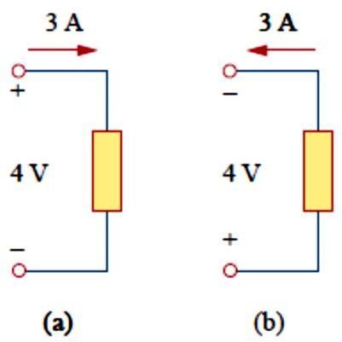
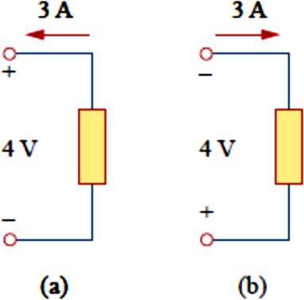
Unless otherwise stated, we will follow the passive sign convention throughout this text. For example, the element in both circuits of Fig. 1.8 has an absorbing power of +12 W because a positive current enters the positive terminal in both cases. In Fig. 1.9, however, the element is supplying power of +12 W because a positive current enters the negative terminal. Of course, an absorbing power of −12 W is equivalent to a supplying power of +12 W. In general,
+ Power absorbed = − Power supplied
Fig. 1.8 Fig. 1.9
In fact, the law of conservation of energy must be obeyed in any electric circuit. For this reason, the algebraic sum of power in a circuit, at any instant of time, must be zero:
∑ 𝑝 = 0 (1.8)
This again confirms the fact that the total power supplied to the circuit must balance the total power absorbed.
From Eq. (1.6), the energy absorbed or supplied by an element from time
𝑡_{𝑜} to time 𝑡 is
𝑡 𝑡
𝑤 = ∫ 𝑝 𝑑𝑡 = ∫ 𝑣𝑖 𝑑𝑡 (1.9)
𝑡𝑜 𝑡𝑜
Energy is the capacity to do work, measured in joules (J).

Slide 7
The electric power utility companies measure energy in watt-hours (Wh), where
1 𝑊ℎ = 3600 𝐽
Example 1.4
An energy source forces a constant current of 2 A for 10 s to flow through a lightbulb. If 2.3 kJ is given off in the form of light and heat energy, calculate the voltage drop across the bulb.
Practice Problem 1.4
To move charge q from point a to point b requires J. Find the voltage drop 𝑣_{𝑎𝑏} if (𝑎) 𝑞 = 2 𝐶, (𝑏) 𝑞 = −6 𝐶.
𝐴𝑛𝑠𝑤𝑒𝑟 (𝑎) − 15 𝑉, (𝑏) 5𝑉

Slide 8
Example 1.5
Find the power delivered to an element at 𝑡 = 3 𝑚𝑠 if the current entering its positive terminal is
𝑖 = 5 cos 60𝜋𝑡 𝐴
and the voltage is : (𝑎) 𝑣 = 3𝑖, (𝑏) 𝑣 = ^{3𝑑𝑖}.
𝑑𝑡
𝐴𝑛𝑠𝑤𝑒𝑟 (𝑎)53.48 𝑊, (𝑏) − 6.396 𝐾𝑊
Practice Problem 1.5
Find the power delivered to the element in Example 1.5 at 𝑡 = 5 𝑚𝑠 if the current remains the same but the voltage is: (𝑎) 𝑣 = 2𝑖 𝑉, (𝑏) 𝑣 =
𝑡
(10 + 5 ∫ 𝑖 𝑑𝑡) 𝑉.
0
𝐴𝑛𝑠𝑤𝑒𝑟 (𝑎) 17.27 𝑊, (𝑏) 29.7 𝑊

Slide 9
Example 1.6
How much energy does a 100-W electric bulb consume in two hours?
𝐴𝑛𝑠𝑤𝑒𝑟: 720 𝐾𝐽
Practice Problem 1.6
A stove element draws 15 A when connected to a 240-V line. How long does it take to consume 60 kJ?
𝐴𝑛𝑠𝑤𝑒𝑟 ∶ 16.667 𝑠

Slide 10
1-6 Circuit Elements
As we discussed in Section 1.1, an element is the basic building block of a circuit. An electric circuit is simply an interconnection of the elements.
Circuit analysis is the process of determining voltages across (or the currents through) the elements of the circuit. There are two types of elements found in electric circuits: passive elements and active elements. An active element is capable of generating energy while a passive
element is not. Examples of passive elements are resistors, capacitors, and inductors. Typical active elements include generators, batteries, and
operational amplifiers. Our aim in this section is to gain familiarity with some important active elements. The most important active elements are
voltage or current sources that generally deliver power to the circuit connected to them. There are two kinds of sources: independent and dependent sources.
An ideal independent source is an active element that provides a
specified voltage or current that is completely independent of other circuit elements.
In other words, an ideal independent voltage source delivers to the circuit whatever current is necessary to maintain its terminal voltage. Physical sources such as batteries and generators may be regarded as approximations to ideal voltage sources. Figure 1.10 shows the symbols for independent voltage sources. Notice that both symbols in Fig. 1.10(a) and (b) can be used to represent a dc voltage source, but only the symbol in Fig. 1.10(a) can be used for a time-varying voltage source. Similarly, an ideal independent current source is an active element that provides a specified current completely independent of the voltage across the source. That is, the current source delivers to the circuit whatever voltage is

Slide 11
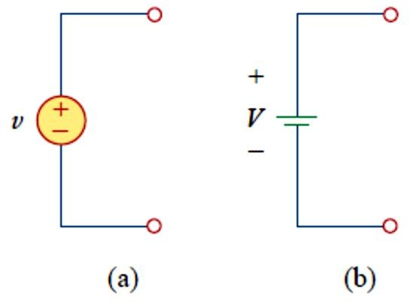
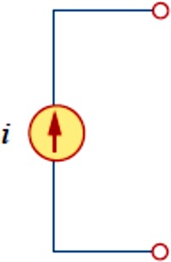
necessary to maintain the designated current. The symbol for an independent current source is displayed in Fig. 1.11, where the arrow indicates the direction of current i.
Fig. 1.10 Symbols for independent voltage sources:
(a) used for constant or time-varying voltage, (b) used for constant voltage (dc).
Fig. 1.11 Symbol for independent current source.
An ideal dependent (or controlled) source is an active element in
which the source quantity is controlled by another voltage or current.
Dependent sources are usually designated by diamond-shaped symbols, as shown in Fig. 1.12. Since the control of the dependent source is achieved by a voltage or current of some other element in the circuit, and the source can be voltage or current, it follows that there are four possible types of dependent sources, namely:
A voltage-controlled voltage source (VCVS).
A current-controlled voltage source (CCVS).

Slide 12
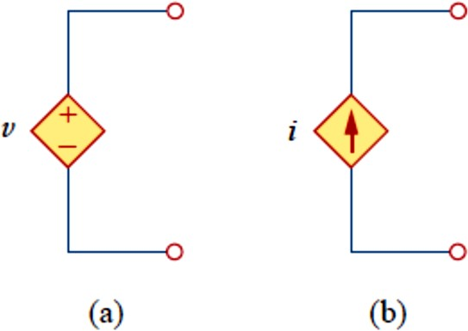
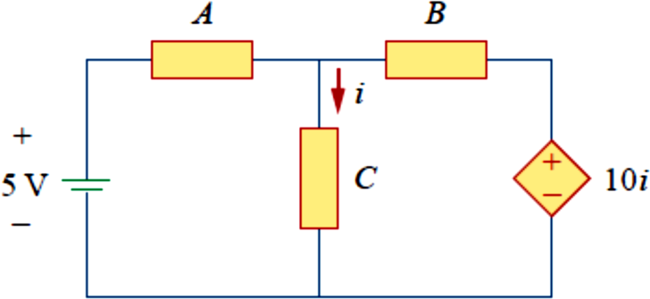
A voltage-controlled current source (VCCS).
A current-controlled current source (CCCS).
Fig. 1.12 Symbols for: (a) dependent voltage source, (b) dependent current source.
Dependent sources are useful in modeling elements such as transistors, operational amplifiers, and integrated circuits. An example of a current- controlled voltage source is shown on the right-hand side of Fig. 1.13, where the voltage of the voltage 10𝑖 source depends on the current i through element C. Students might be surprised that the value of the dependent voltage source is 10𝑖 V (and not 10𝑖 A) because it is a voltage source. The key idea to keep in mind is that a voltage source comes with polarities (+ − ) in its symbol, while a current source comes with an arrow, irrespective of what it depends on.
Fig. 1.13
The source on the right-hand side is a current-controlled voltage source.

Slide 13
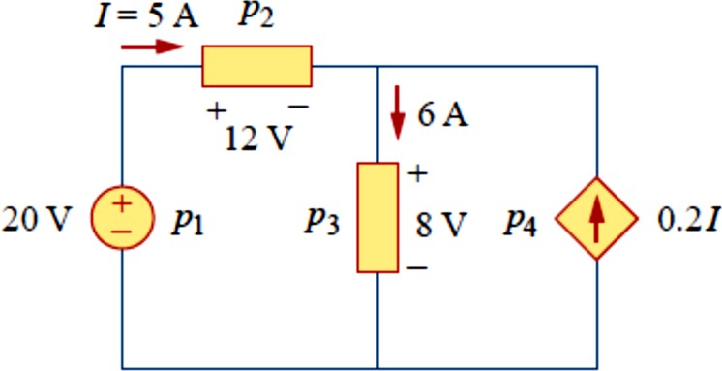
It should be noted that an ideal voltage source (dependent or independent) will produce any current required to ensure that the terminal voltage is as stated, whereas an ideal current source will produce the necessary voltage to ensure the stated current flow. Thus, an ideal source could in theory supply an infinite amount of energy. It should also be noted that not only do sources supply power to a circuit, they can absorb power from a circuit too. For a voltage source, we know the voltage but not the current supplied or drawn by it. By the same token, we know the current supplied by a current source but not the voltage across it.
Example 1.7
Calculate the power supplied or absorbed by each element in Fig. 1.14.
Fig. 1.14

Slide 14
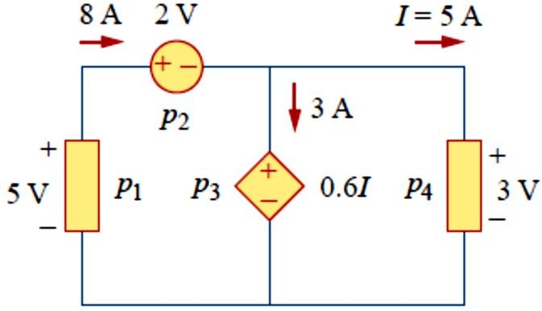
Practice Problem 1.7
Compute the power absorbed or supplied by each component of the circuit in Fig. 1.15.
𝐴𝑛𝑠𝑤𝑒𝑟: 𝑝₁ = −40 𝑊, 𝑝₂ = 16 𝑊, 𝑝₃ = 9 𝑊, 𝑝₄ = 15 𝑊

